Slide 1
FINDING MISSING PERSON USING AI
Ancila M
FIT20MCA-2019

Slide 2
Relevance of the topic
Nowadays to find a missing person is very hard task, although we all are updated by social media, it requires numerous paper work to be done and it is time consuming process and also after doing this hard work, there are not much chances of proper result.
Physically it takes huge time, as it is lengthy procedure for finding missing person as it increases time to launch an FIR in police station.
Also during handy process workforce for searching missed person is not so great and due to this half of the cases remain mysterious. An alarming fact about India’s missing children/person goes missing every day on. And half of them remain untraceable.
Hence to resolve this, We are developing Finding missing person using AI

Slide 3
Description
Face recognition is a biometric-based technology that mathematically maps a particular person’s or individual’s facial features and stores all that data.
The software uses machine learning algorithms to compare a captured image to the stored face print to verify one’s identity.
By using this technique, the information of the face of a person is saved mathematically or in the format of graphs in the database, which is used for detecting that particular face.
Face recognition model in our system will find a match of that person in the database. If a match is found, it will be notified to the police and the guardian of that person.

Slide 4
Objectives
The usual process to track a person is using investigation which requires time and experience. Most of the time, investigation method works pretty well but it is time consuming and can be unsuccessful if the person (missing) has been shifted/moved to different location
The objective of this project is to help Police and higher authorities to track down missing people quickly.
This project can also be helpful to common people.

Slide 5
Tools
PYTHON
Python is a free, open-source programming language that is available for everyone to use. It also has a huge and growing ecosystem with a variety of open-source packages and libraries.
POSTGRESQL
Postgresql is a open source Relational Database Management System. It is used to directly interact with data on database. Many users can use it, and provide data to the database

Slide 6
Modules
Admin(includes Police)
Registering Complaint of the missing person.
Details of the missing person like guardian’s name, mobile number are also provided
Submitting image, location, and time at which the person went missing.
User
Recognizing the missing person and submitting there photograph to the application.
Adding the details of the photo taken like location and time.

Slide 7
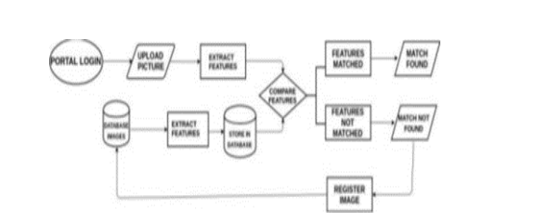
Proposed System

Slide 8
Proposed System
Login and register the complaint.
Fill the details such as name of missing person, location, age and then upload the image of missing person.
Search the uploaded image with stored database, if found then give result as match found and if not then store as new entry.
Image of the suspected person is uploaded with there location , And if there finds a match ,then the status changes from “Not found” to Found

Slide 9
Algorithms to be used
KNN Algorithm
K-Nearest Neighbour is one of the simplest Machine Learning algorithms based on Supervised Learning technique.
K-NN algorithm assumes the similarity between the new case/data and available cases and put the new case into the category that is most similar to the available categories.
K-NN algorithm stores all the available data and classifies a new data point based on the similarity. This means when new data appears then it can be easily classified into a well suite category by using K- NN algorithm.

Slide 10
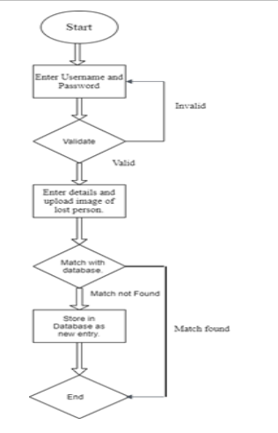
METHODOLOGY

Slide 11
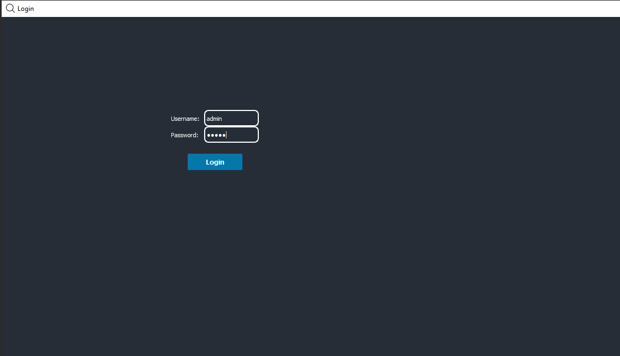
Screenshots
Login Page

Slide 12
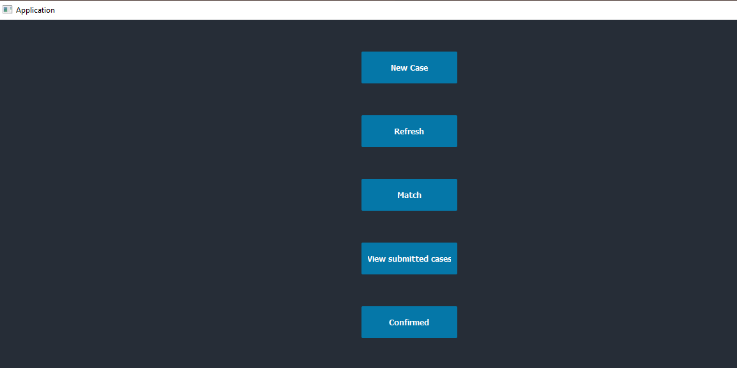
SCREENSHOTS
Application Page

Slide 13
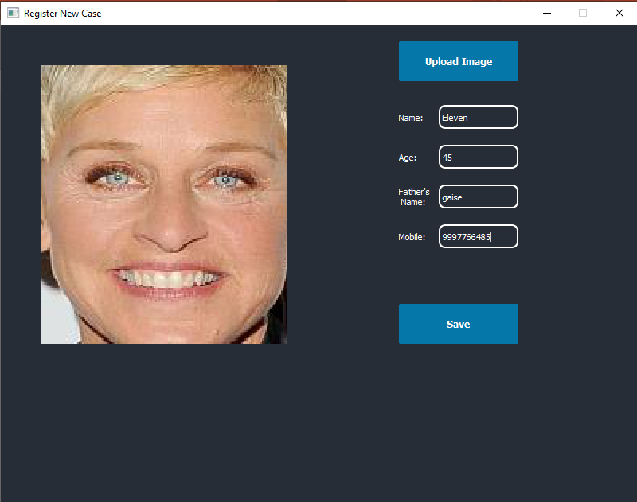
SCREENSHOTS
Registering New Case

Slide 14
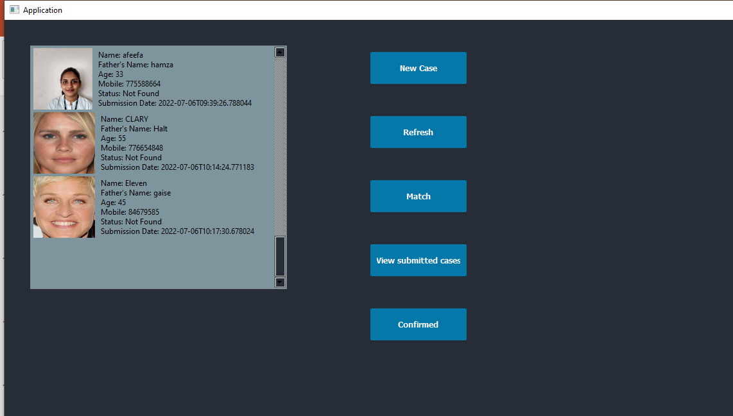
Submitted Cases

Slide 15
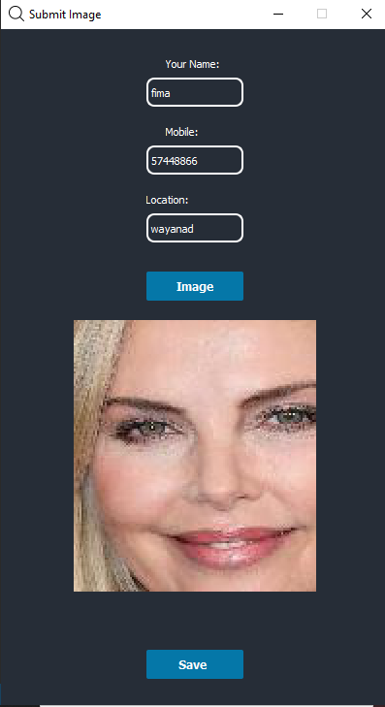
SUBMIT IMAGE

Slide 16
THANK YOU

